Slide 1

Capstone Project
Clustering the Neighborhoods of New York and Toronto

Slide 2
1. Introduction
New York City and Toronto are the financial capitals of their respective countries. In this project, I am going to explore their neighborhoods and find out the top 10 common venues for each neighborhood.

Slide 3
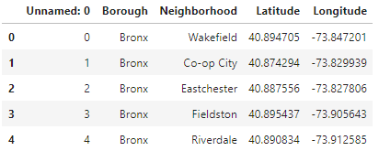
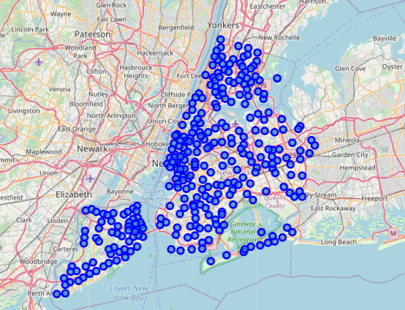
2. Data used
A list of neighborhoods of New York City

Slide 4
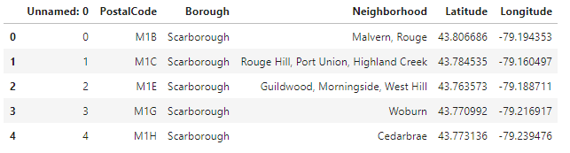
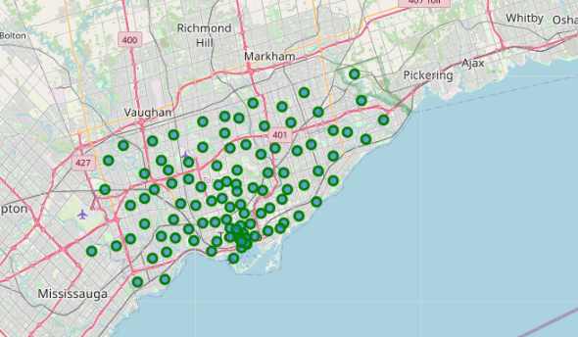
2. Data used
A list of neighborhoods of Toronto

Slide 5
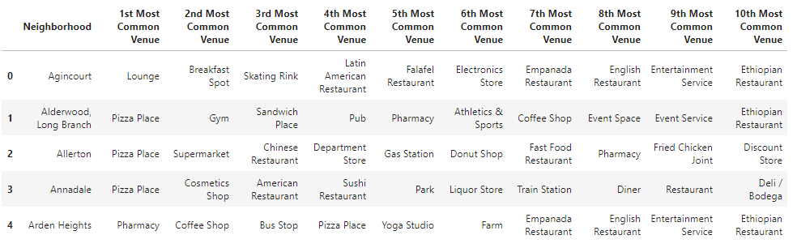
2. Data used
Top 10 venues and categories of each neighborhood of New York and Toronto using Foursquare API

Slide 6
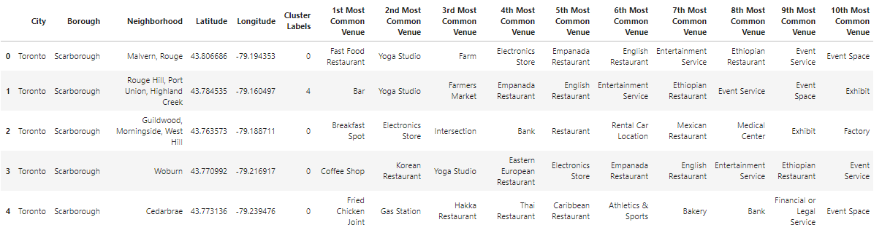
3. Methodology
K-mean Clustering analysis
K-Cluster= 5
Clusters: “0”, “1”, “2”, “3” and “4”.

Slide 7
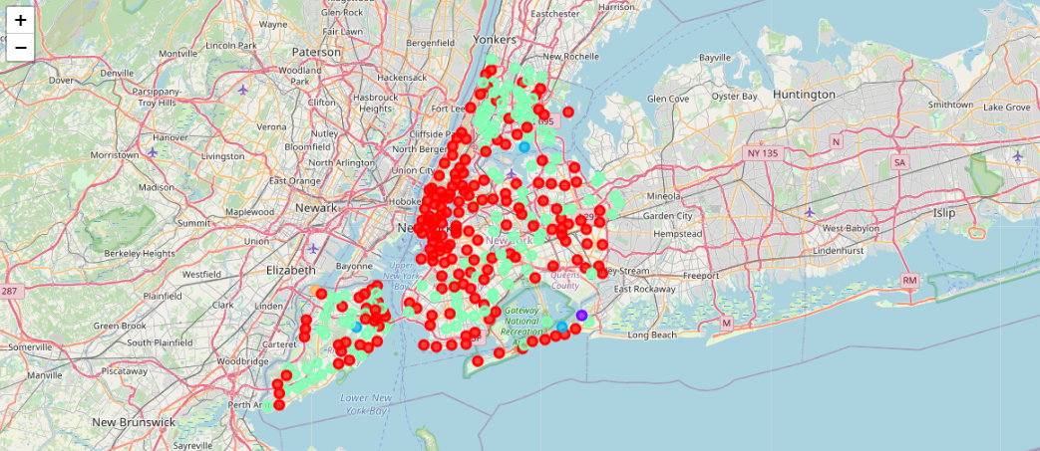
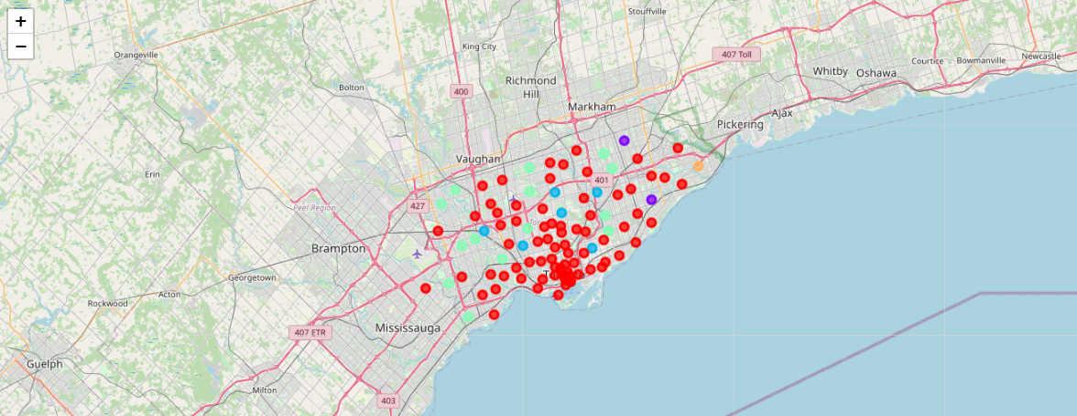
3. Methodology
New York:
Toronto:

Slide 8
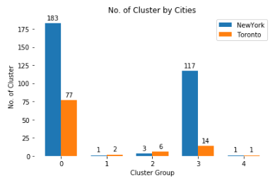
4. Analysis and Result

Slide 9
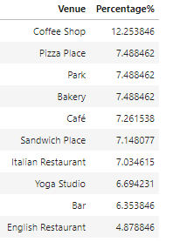
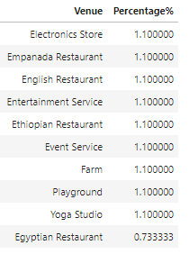
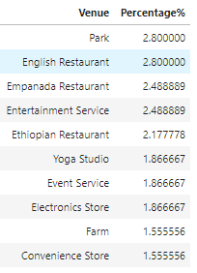
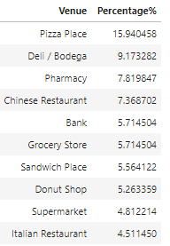
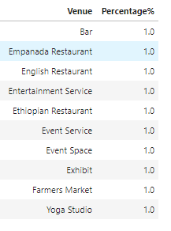
4. Analysis and Result
Cluster 0
Cluster 3
Cluster 4
Cluster 0
Cluster 1
Cluster 2

Slide 10
4. Analysis and Result
In cluster 0, New York has 183 venues and Toronto has 77 venues; In cluster 3, New York has 117 venues and Toronto has 14 venues. In other clusters, New York and Toronto only has less than 10 venues.
In Cluster 0, Coffee Shop are the most common venues which cover 12.25%; In Cluster 3, Pizza Place is the most common venues which cover 15.94%.

Slide 11
5. Conclusion
Show the most common venues for each cluster.
Identify what venues the people in the financial capital: New York City and Toronto are most likely to go.

